Slide 1
State on Week 4 for Systematic Literature Review
Oleg Ostapovich, Vladimir Klepikov, Mark Vishnevskiy, Amir Zakirov, and Abdul Rahman Takriti

Slide 2
Quick recap
Theme: LiDAR and Visual Odometry Methods in Simultaneous Localization and Mapping for Unmanned Aerial Vehicles
Keywords:
SLAM
visual odometry
LiDAR odometry
UAV
Navigation
sensor fusion
Mapping
RGB camera

Slide 3
Bugfix from previous week
Inclusion criteria:
- Article is peer reviewed and authors h-index at least 5
- Article is in English. We decided to focus on sources in English since the overwhelming amount of peer reviewed research was in English
- Paper published between 2019 - 2023
- Represents materials that have examples of practical application, including tests on UAVs
- Uses same kind of sensors

Slide 4
Bugfix
Exclusion criteria:
Uses stereocamera
Uses outdated versions of same method

Slide 5
Our work from this week
Queries
Articles from this queries
Review of articles
Main ideas

Slide 6
Queries
SLAM OR visual odometry OR LiDAR OR odometry OR UAV OR navigation OR sensor OR fusion OR mapping.
SLAM AND LiDAR AND odometry AND UAV
LiDAR AND odometry AND UAV AND navigation
Odometry or localization or mapping or Odometry or SLAM And Camera or imu or lidar or gnss or gps
UAV or drone or plane And Odometry or localization or mapping or Odometry or SLAM

Slide 7
Database we use
Google Scholar
Science Direct
Research Gate

Slide 8
Reviewed Articles
A portable UAV-based laser-induced fluorescence lidar system for oil pollution and aquatic environment monitoring
Potential of UAV-based sun-induced chlorophyll fluorescence to detect water stress in sugar beet
Experimental tests and radiometric calculations for the feasibility of fluorescence LIDAR-based discrimination of oil spills from UAV
A Comparison of LiDAR-based SLAM Systems for Control of Unmanned Aerial Vehicles
RTLIO: Real-Time LiDAR-Inertial Odometry and Mapping for UAVs
VIRAL SLAM: Tightly Coupled Camera-IMU-UWB-Lidar SLAM
Tightly-coupled camera/LiDAR integration for point cloud generation from GNSS/INS-assisted UAV mapping systems
Robust Autonomous Landing of UAV in Non-Cooperative Environments based on Dynamic Time Camera-LiDAR Fusion

Slide 9
Reviewed Articles
DV-LOAM: Direct Visual LiDAR Odometry and Mapping
R3LIVE: A Robust, Real-time, RGB-colored, LiDAR-Inertial-Visual tightly-coupled state Estimation and mapping package
Robust GNSS-denied localization for UAV using particle filter and visual odometer
FAST-LIO: A Fast, Robust LiDAR-inertial Odometry Package by Tightly-Coupled Iterated Kalman Filter
Review of SLAM Algorithms for Indoor Mobile Robot with LIDAR and RGB-D Camera Technology
A General Optimization-based Framework for Global Pose Estimation with Multiple Sensors
A GNSS/INS/LiDAR Integration Scheme for UAV-Based Navigation in GNSS-Challenging Environments

Slide 10
Main Ideas from articles
Generally, we have 3 groups:
First group – LiDAR and camera combination for precision improvement and data calibration
Second – GPS, camera, LiDAR data combining for SLAM
Third – algorithms comparison
Technically, we found many algorithms for out task, so, we can assemble data for our research

Slide 11
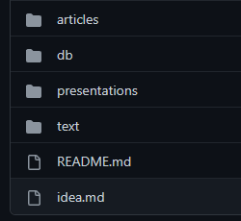
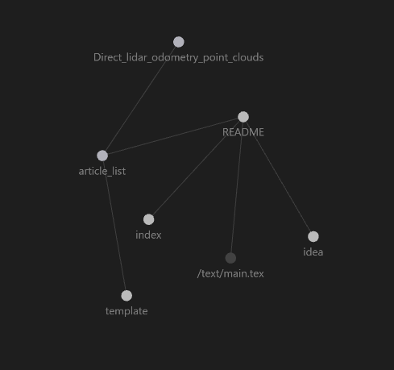
(Some managements features that no one want see)
Now we have git with our notes and Obsidian ideas draft

Slide 12

Thanks!

